Slide 1
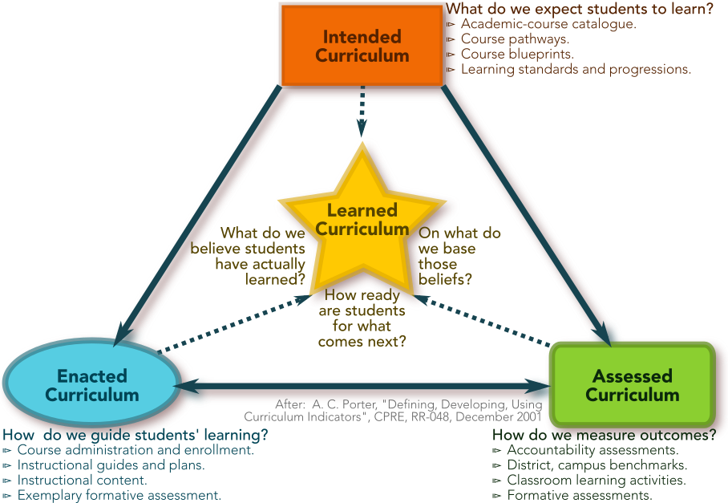
“…students are more likely to learn the content that they are taught.” (Porter 2002)
A. C. Porter and J. L. Smithson, “Defining, developing, and using curriculum indicators,” Report RR-048, Consortium for Policy Research in Education, University of Pennsylvania, December 2001, http://ibm.biz/PorterCurriculumAlignment.
A. C. Porter, “Measuring the content of instruction: Uses in research and practice,” Educational Researcher, October 2002 31(7)3-14, http://ibm.biz/EdRschr_Meas_Cont_Instruction.

Slide 2
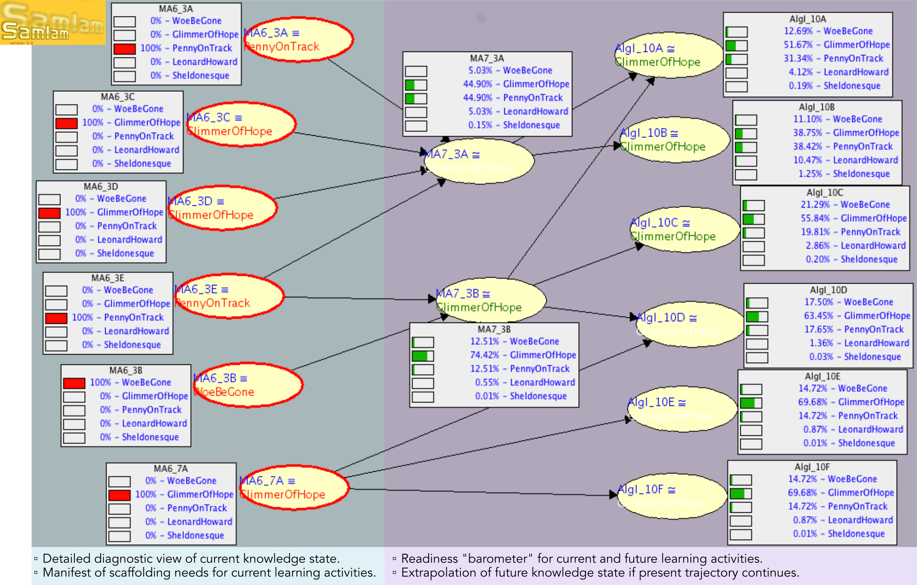
﻿”Students who already know ... should next come to learn ....” (Common-Core State Standards for Mathematics)
Stevens, S., et al, (2002), “Using learning progressions to inform curriculum, instruction and assessment design,” Center for Highly Interactive Educations, Curricula & Computing in Education, School of Education/College of Engineering, University of Michigan, Retrieved on July 24, 2018 from http://ibm.biz/CHICCCE-Progressions.

Slide 3
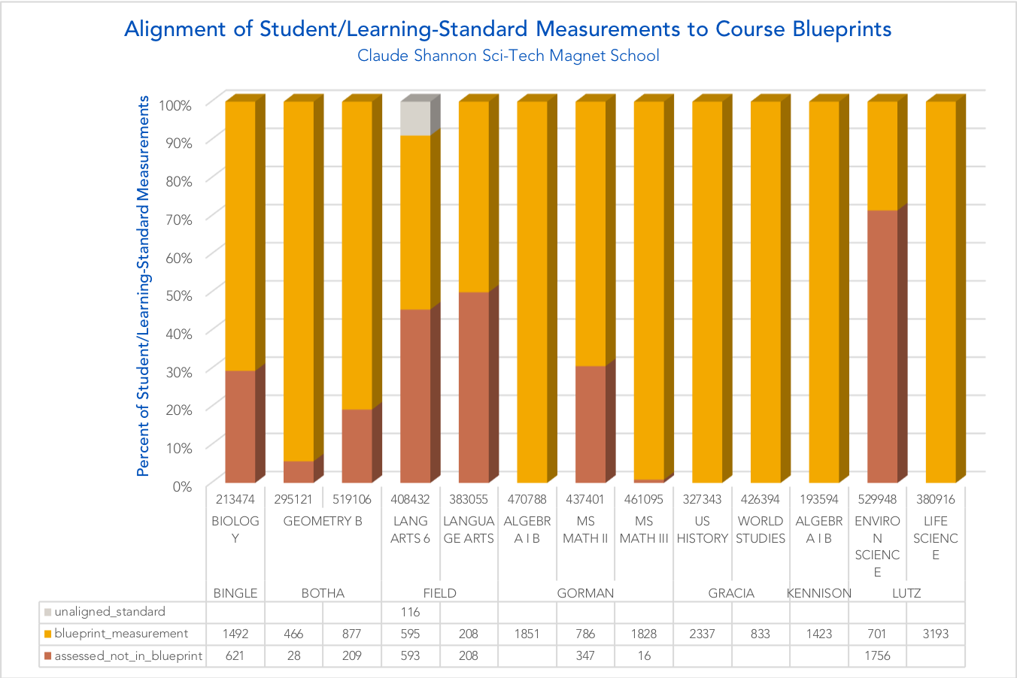
A digitized curriculum allows us to answer questions about what classroom teachers are assessing.
Approximately 32% of the student-proficiency measurements for Thompson’s Biology course measure learning standards other than those in the course blueprint.
Approximately 68% of the student-proficiency measurements for Lutz’ Biology course measure learning standards in the course blueprint.

Slide 4
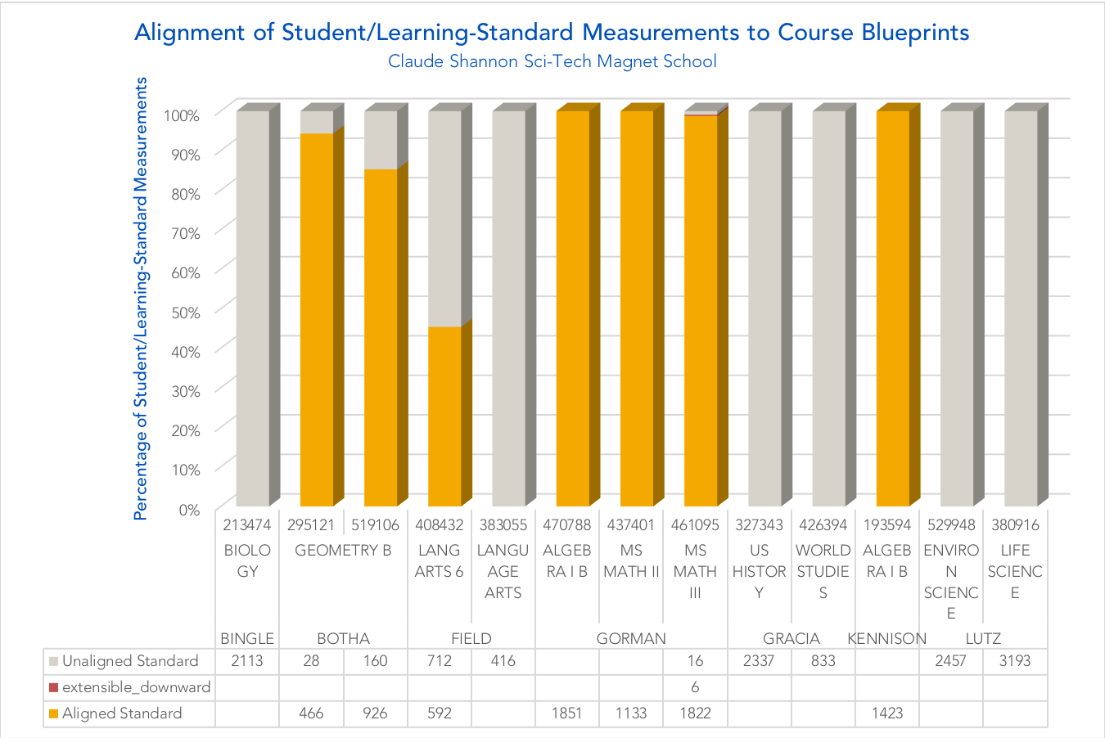
A digitized curriculum allows us to answer questions about what classroom teachers are assessing.
Approximately 55% of the student-proficiency measurements for Thompson’s Biology course measure learning standards other not in the learning-standard progressions and will not influence the Diagnostic Cognitive Model.
Approximately 45% of the student-proficiency measurements for Field’s Language-Arts 6 course measure learning standards in the learning-standard progressions and are employed in the Diagnostic Cognitive Model.

Slide 5
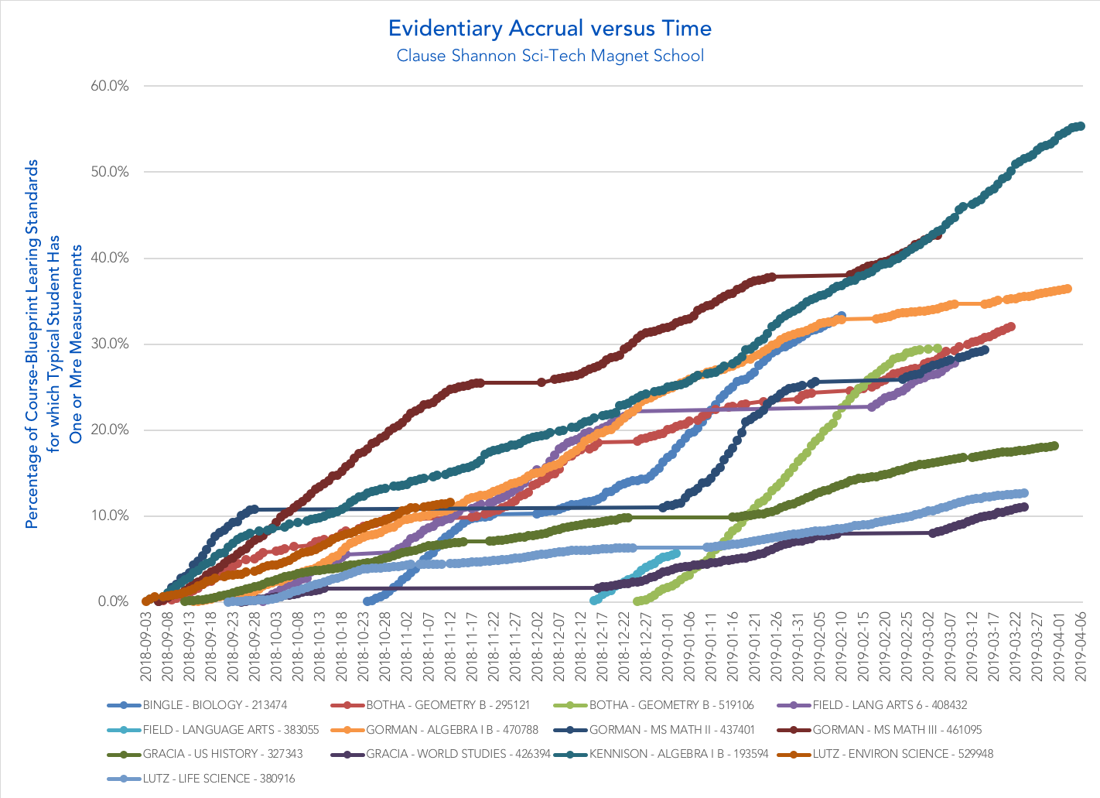
We expect that — as the academic year progresses — each gets assessed for each learning standard in the curriculum.
As of April 6, 2019, the typical student in Kennison’s Algebra I B course has been assessed at least once against 55% of the learning standards in the course blueprint.

Slide 6
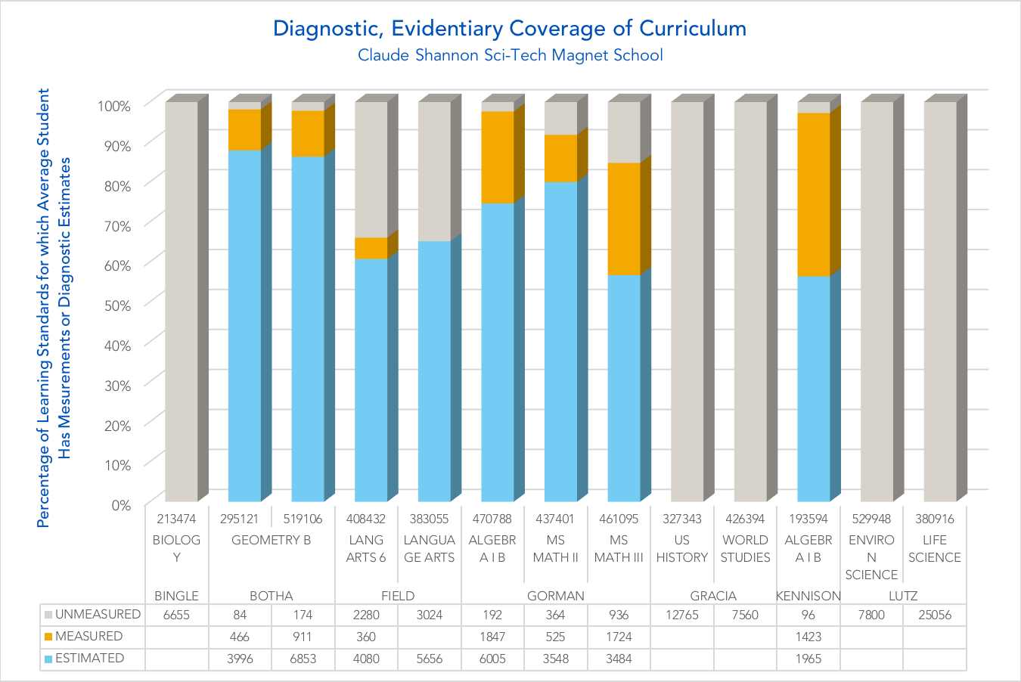
Curriculum digitization also allows us to look at the overall proportion of the curriculum that has been assessed.
The typical student in Kennison’s Algebra I B course has neither assessments nor readiness estimates for 5% of the learning standards in the course blueprint.
The typical student in Kennison’s Algebra I B course has been assessed at least once for about 40% of the learning standards in the course blueprint.
The typical student in Kennison’s Algebra I B course has readiness estimates — from the Diagnostic Cognitive Model — for about 55% of the learning standards in the course blueprint.

Slide 7
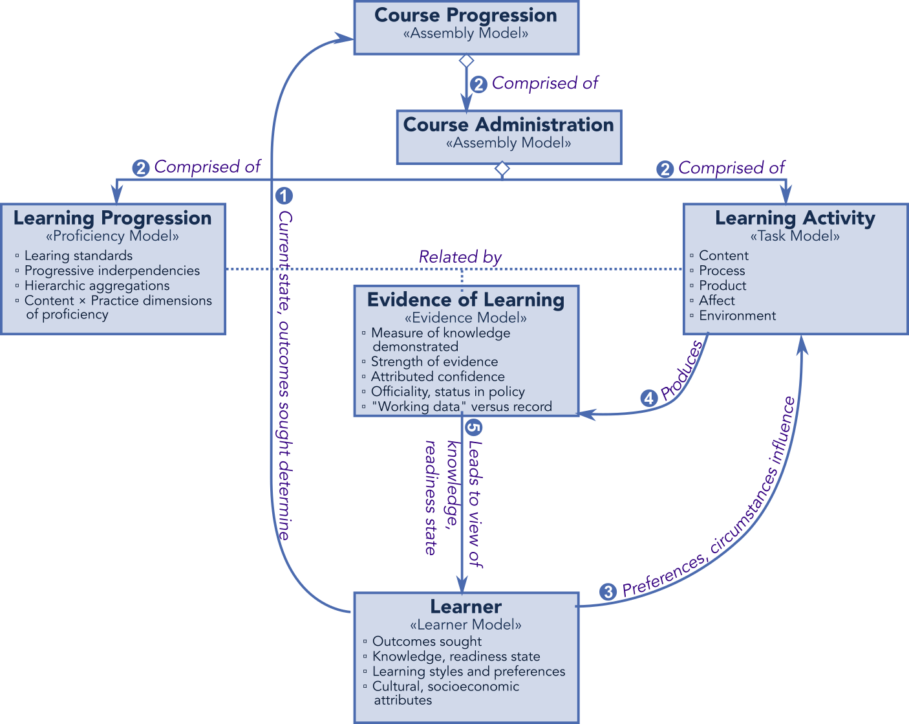
Evidence-Centered Design (ECD) enjoys near-paradigmatic status as a framework for translating evidence into a belief about a learner’s state of knowledge.
R. J. Mislevy, et al, “A brief introduction to evidence-centered design,” Research Report RR-03-16, Educational Testing Service (ETS), July 2003, http://ibm.biz/ETS_ECD_RschRep.
G. Haertel, et al, “General introduction to evidence-centered design”, Meeting the Challenges to Measurement in an Era of Accountability, New York: Routledge, for the National Council on Measurement in Education, 2016, https://amzn.to/2OhMMx7.
A. Rupp, et al, Diagnostic Measurement: Theory, Methods, and Applications, New York: Guilford, 2010, https://amzn.to/2AnMHVy.

Slide 8
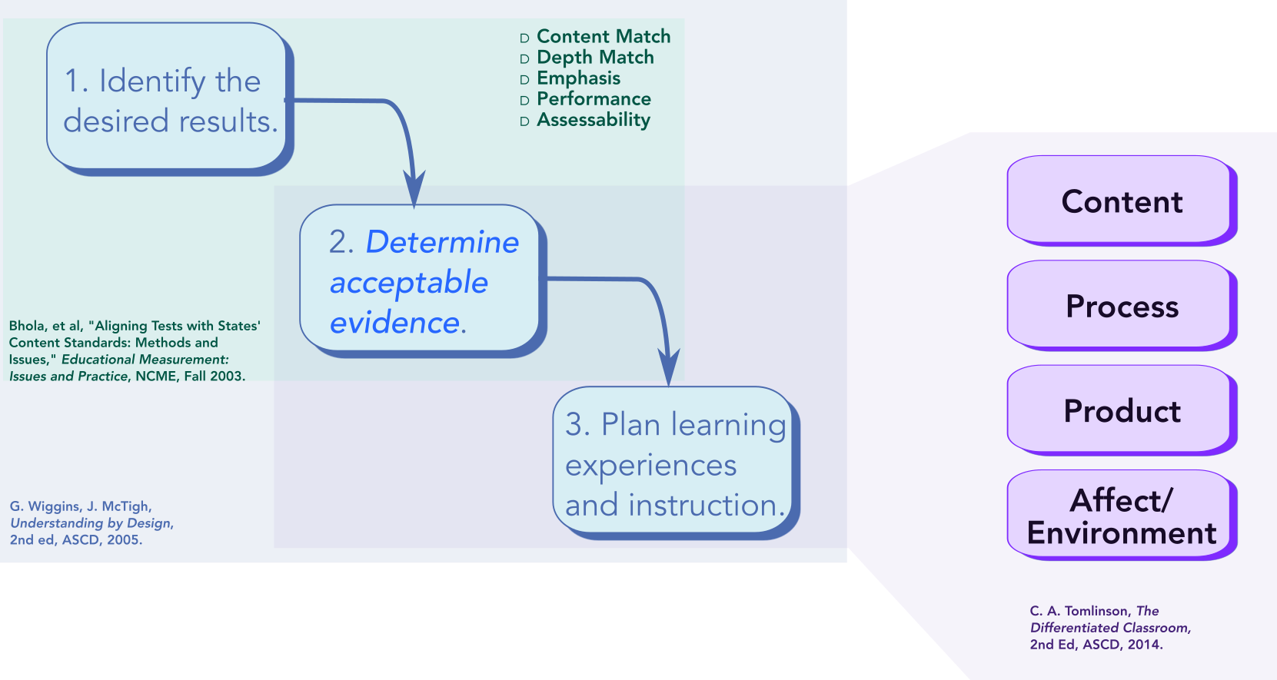
The Understanding by Design framework casts classroom learning as an exercise in collecting evidence of each students’ learning.
D. Bhola, et al, “Aligning tests with states' content standards: Methods and issues,” Education Measurement: Issues and Practices, National Council on Measurements in Education, Fall 2003, http://ibm.biz/NCME-ExamAlgmt.
C. A. Tomlinson, The Differentiated Classroom: Responding to the Needs of All Learners, second edition, Alexandria, VA: ASCD, 2014, http://ibm.biz/ASCD_Tomlinson_DiffCR.
G. Wiggins, J. McTighe, Understanding by Design, second edition, Alexandria, VA: ASCD, 2005, http://ibm.biz/ASCD_UBD_Book.

Slide 9
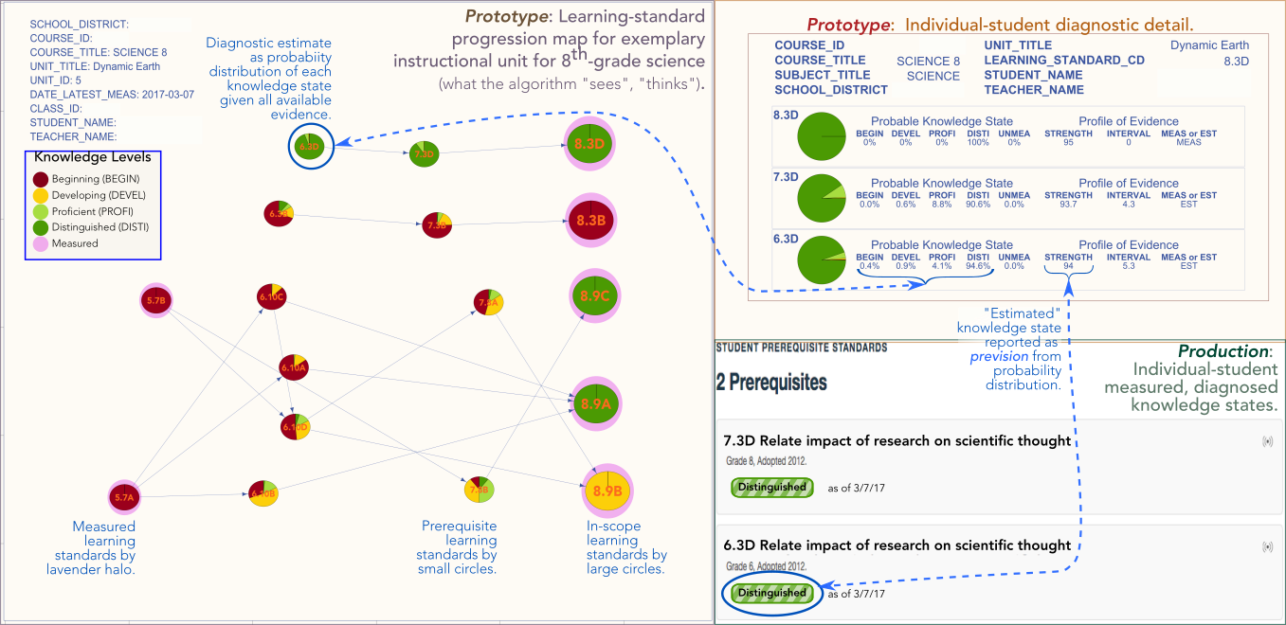
“﻿Learning progressions describe how students gain more expertise within a discipline over a period of time. They … also predict how the knowledge builds over time.” (Stevens)
﻿Stevens, S., et al, (2002), “Using learning progressions to inform curriculum, instruction and assessment design,” Center for Highly Interactive Educations, Curricula & Computing in Education, School of Education/College of Engineering, University of Michigan, Retrieved on July 24, 2018 from http://ibm.biz/CHICCCE-Progressions.

Slide 10
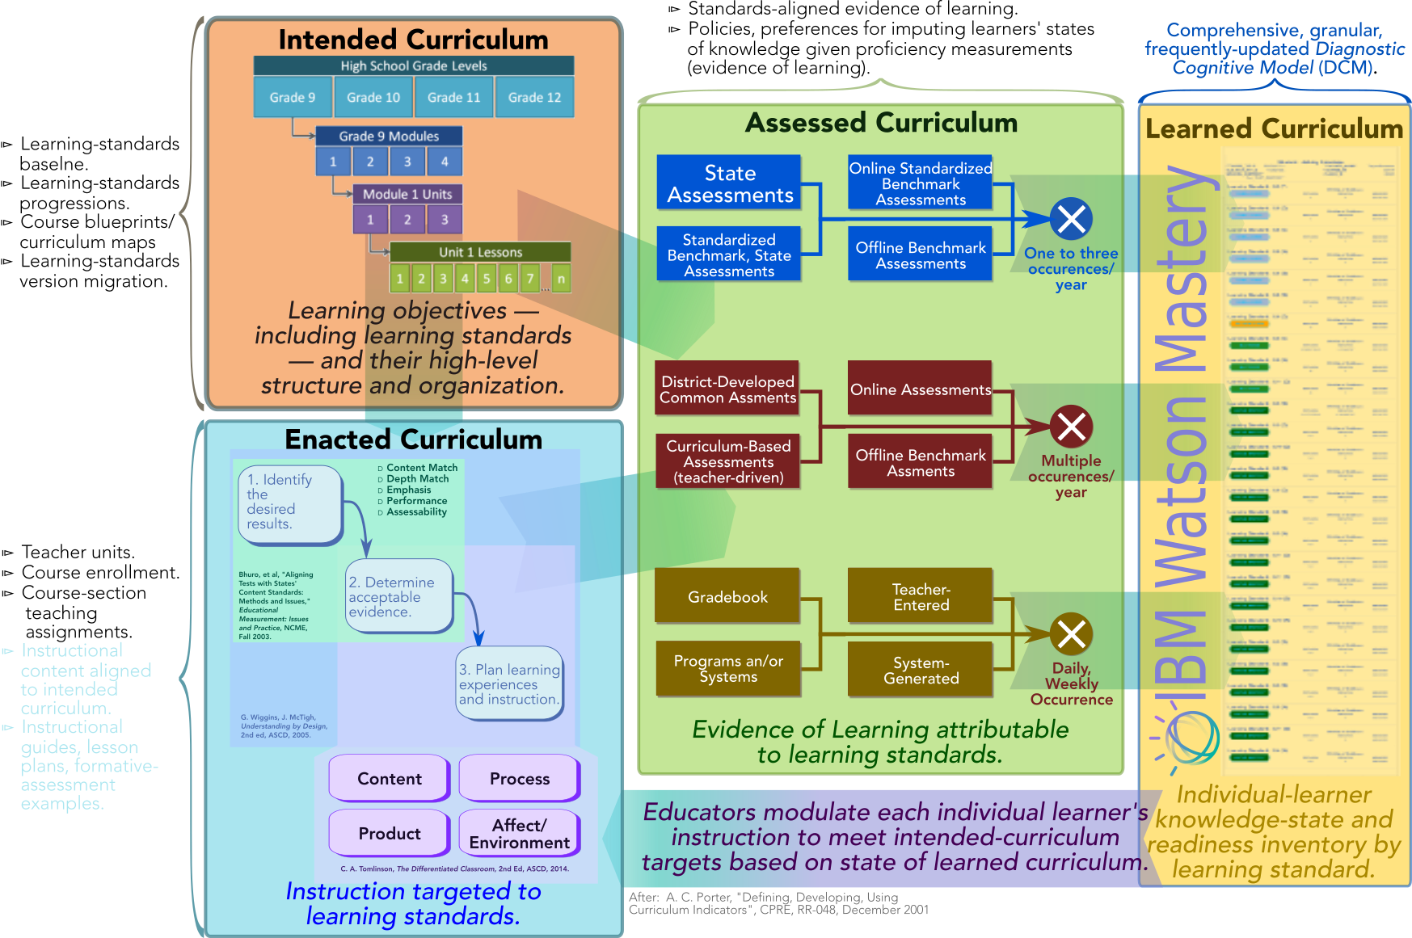
A Well-Aligned Curriculum is one prerequisite to maximizing each student’s Opportunity to Learn (OTL).
A. C. Porter and J. L. Smithson, “Defining, developing, and using curriculum indicators,” Report RR-048, Consortium for Policy Research in Education, University of Pennsylvania, December 2001, http://ibm.biz/PorterCurriculumAlignment.

